Slide 1
Team 2: Predictive Webserver
Members:
Kate Xie, Lindsey Tucker, Ishika Verma, Lee Ellen Mullins, Brendon Cara

Slide 2
Quick Recap:
Why a web server?
Automate annotation of Salmonella strains
Annotate virulence factors and antimicrobial resistance genes
Visualize in interactive genome browser
What technologies we used.

Slide 3
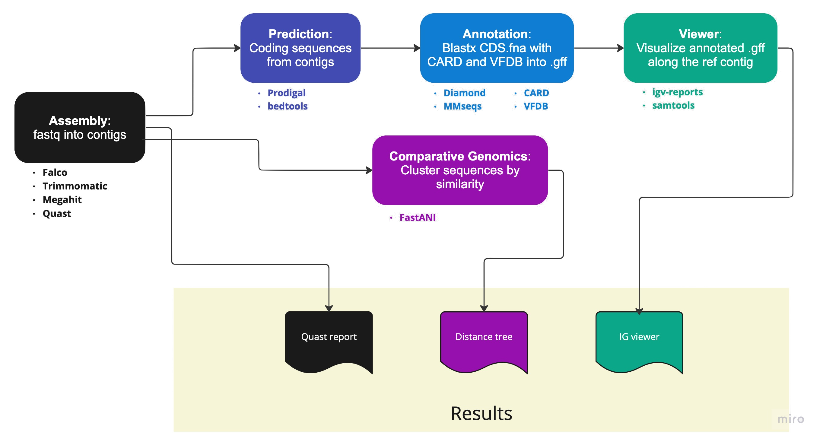
Our Pipeline

Slide 4
Technologies Used

Slide 5
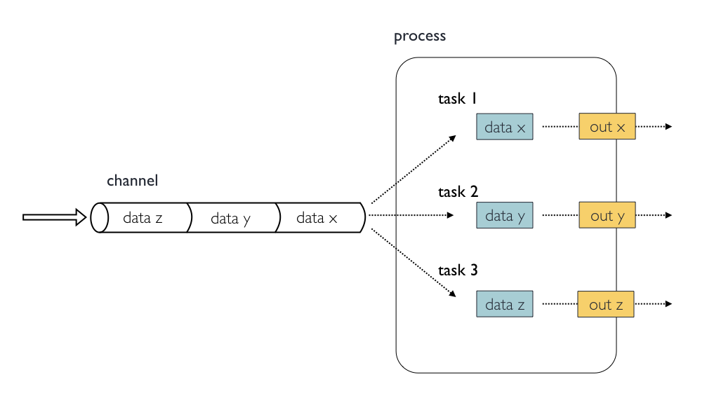
Nextflow
Workflow management
Groovy (Java syntax compatible)
Processes, channels, workflow
Pros
Processes are modular
The channels are easy to call
Cons
Weak v2 documentation
Poor debugging
Extremely path sensitive

Slide 6
Streamlit
Simple web app generator allows generation in python
Configure to run with nginx
About page
Pipeline
Upload files
Enter email to get job ID
Submit button triggers pipeline
Results page
Enter job ID
Displays results

Slide 7
streamlit demo video

Slide 8

Streamlit
Simple web app generator in python
Configure to run with nginx
About page
Pipeline
Upload files
Enter email to get job ID
Submit button triggers pipeline
Results page
Enter job ID
Displays results
Thank you, Troy!

Slide 9
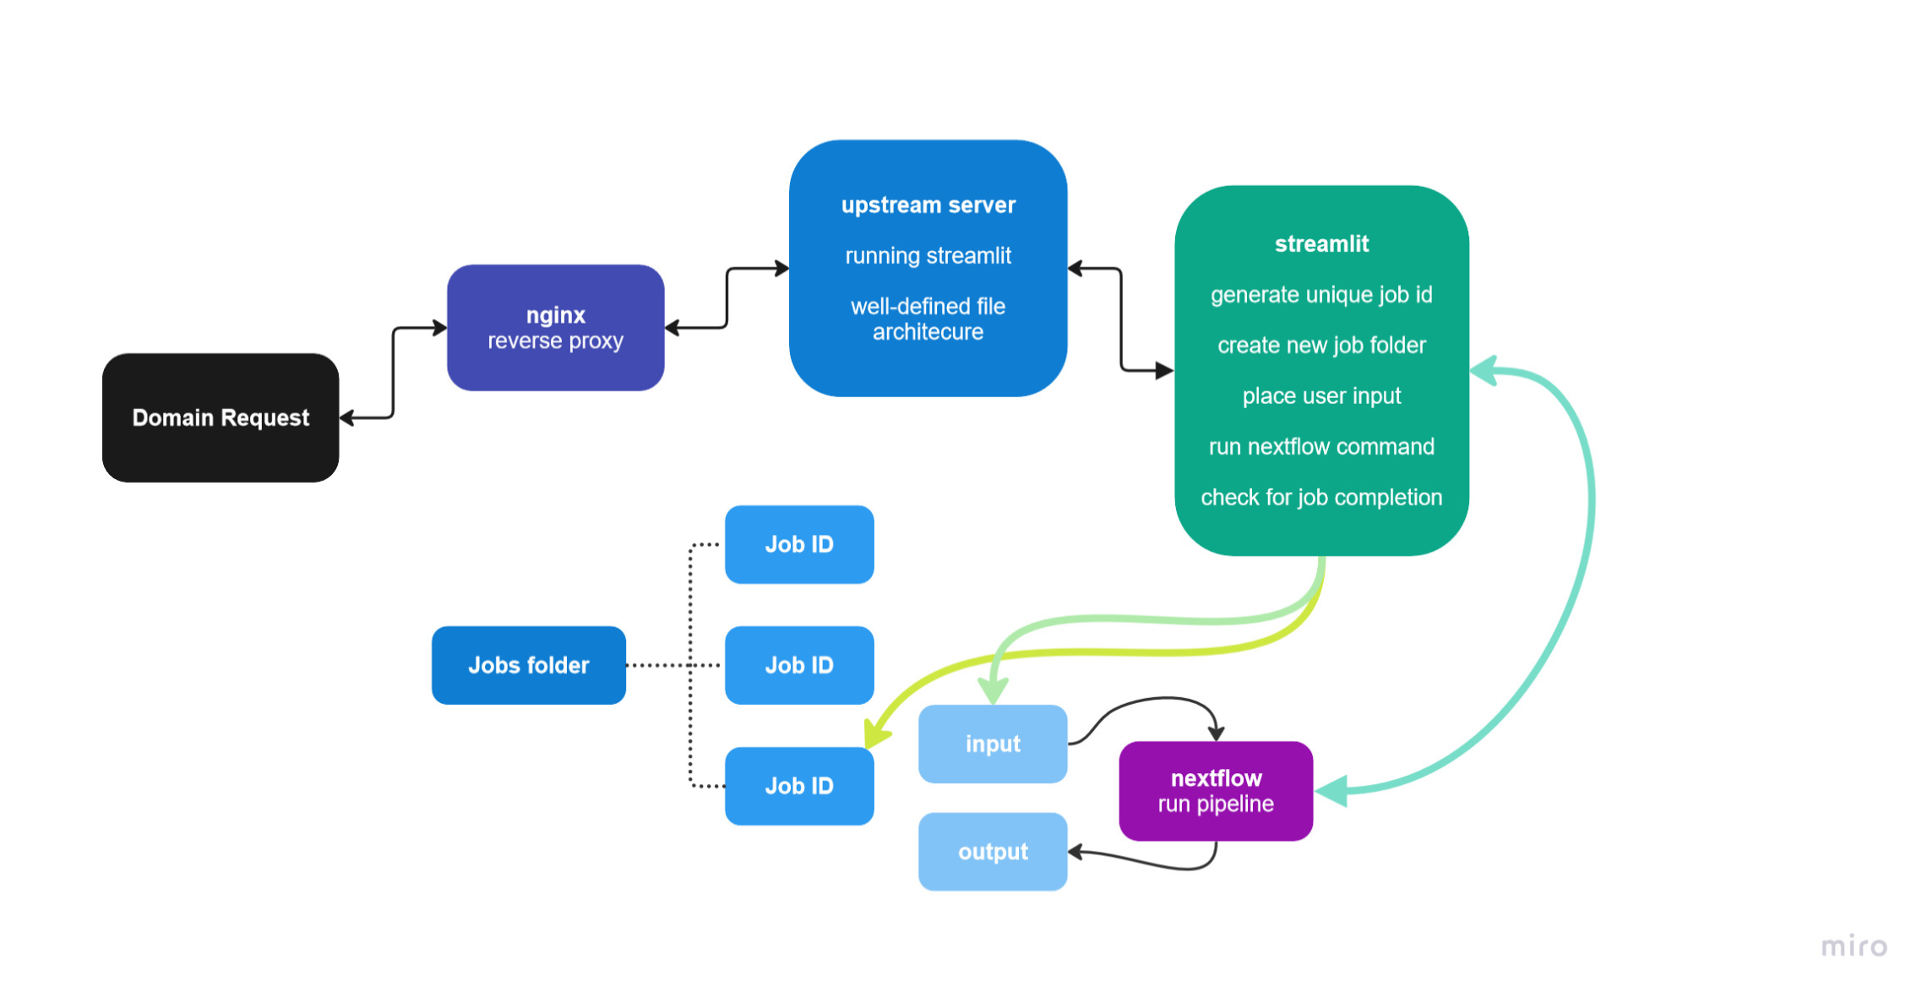
Web-server Implementation

Slide 10
Demo Time

Slide 11
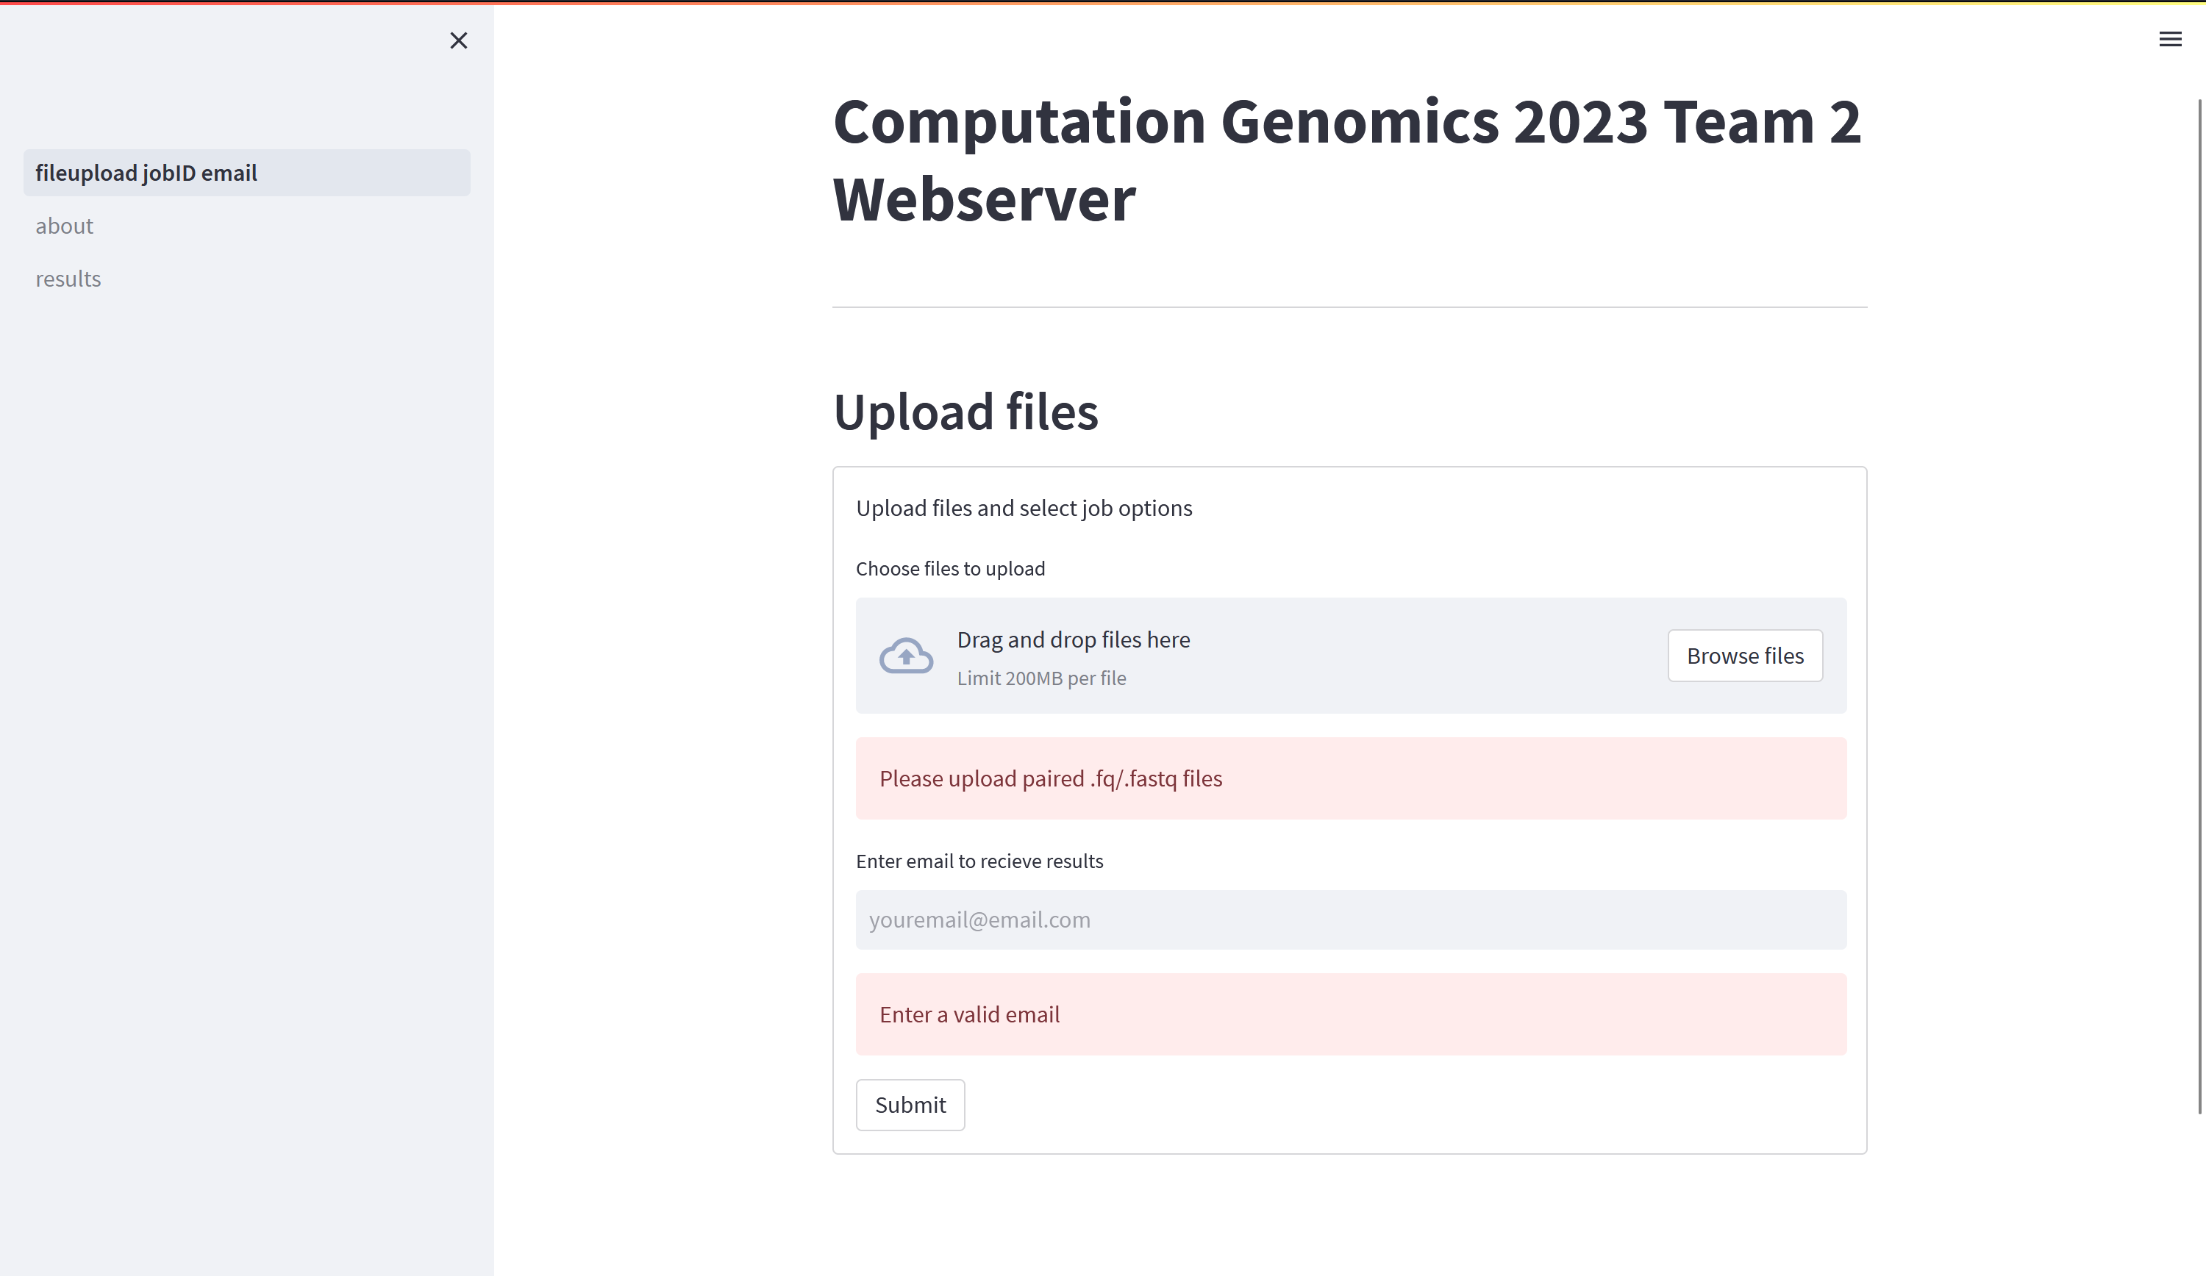
Input Page

Slide 12
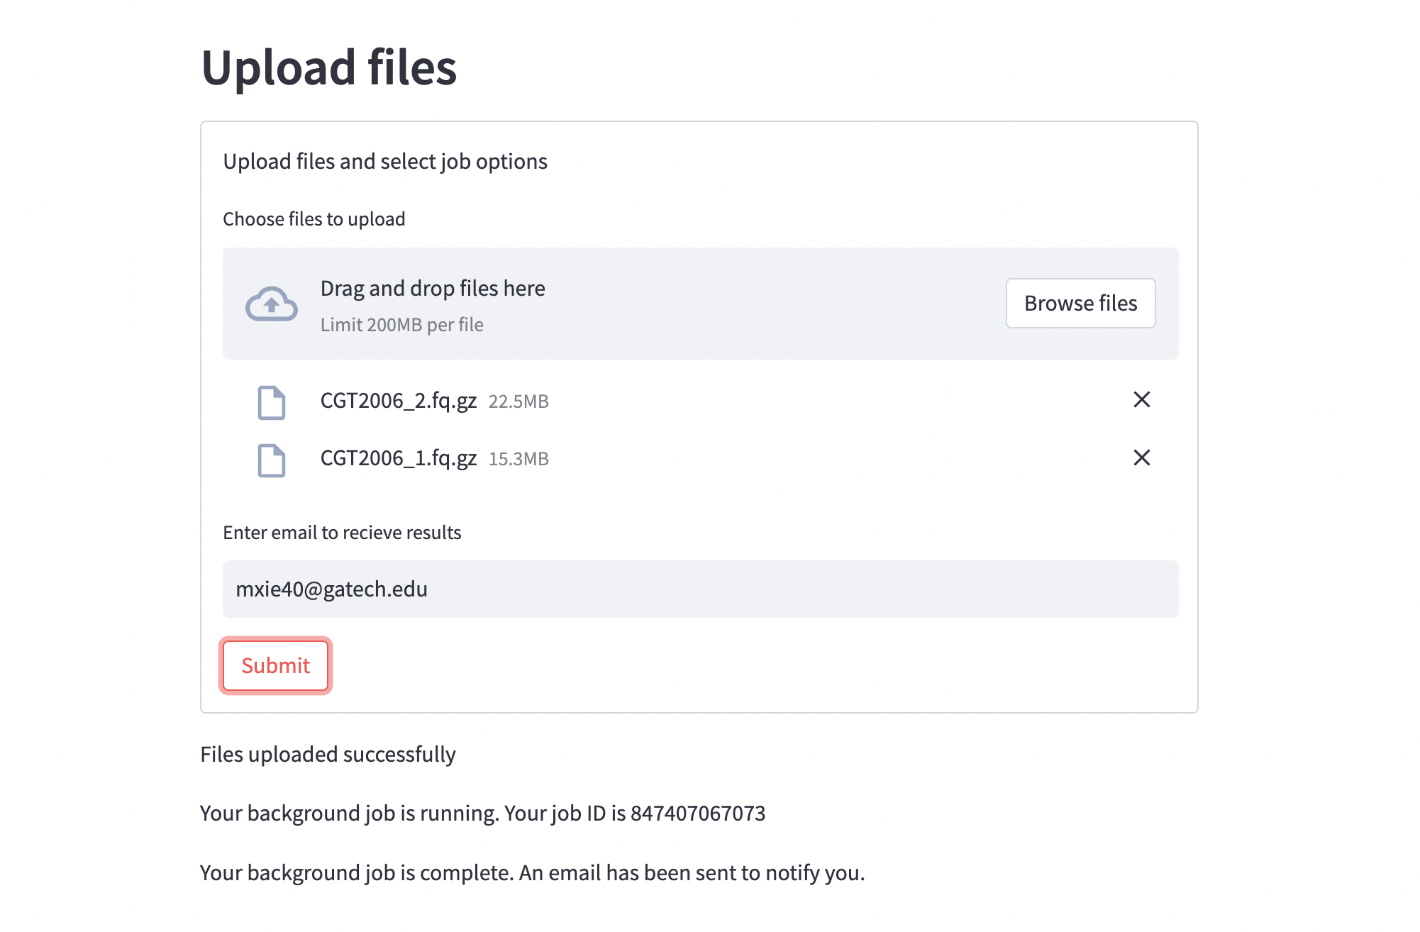

Slide 13
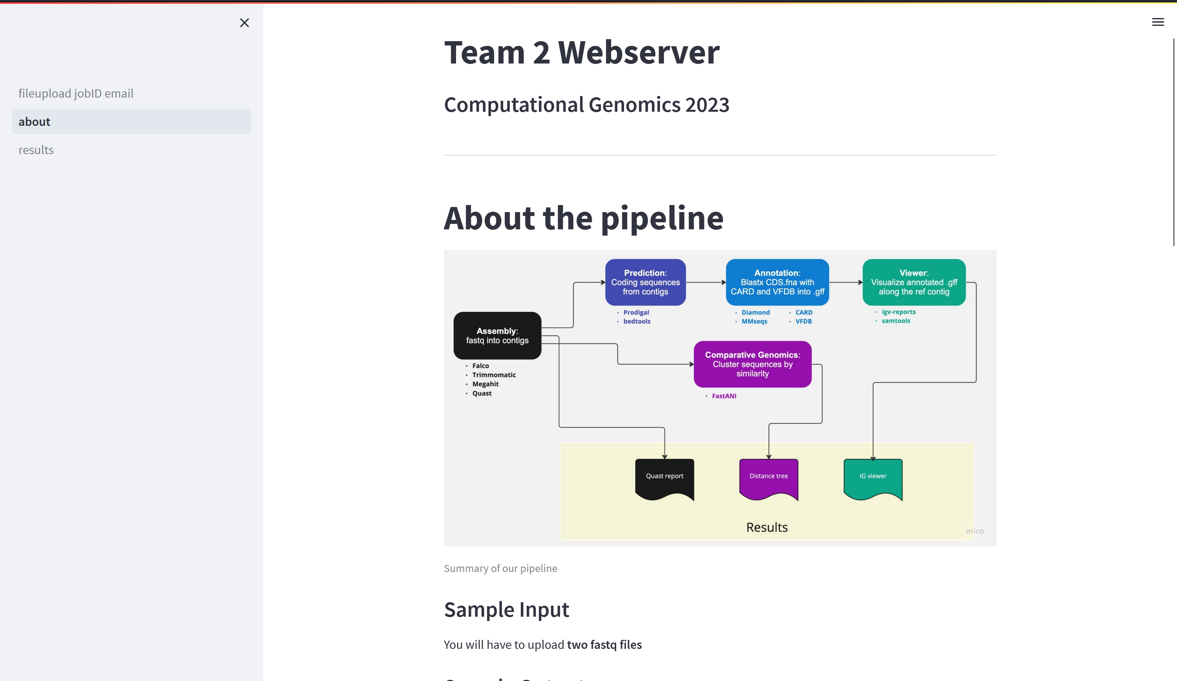
About Pipeline Page

Slide 14
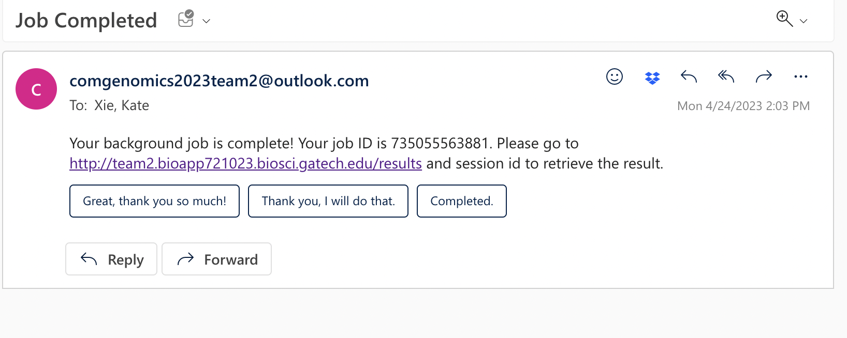
Sample email

Slide 15
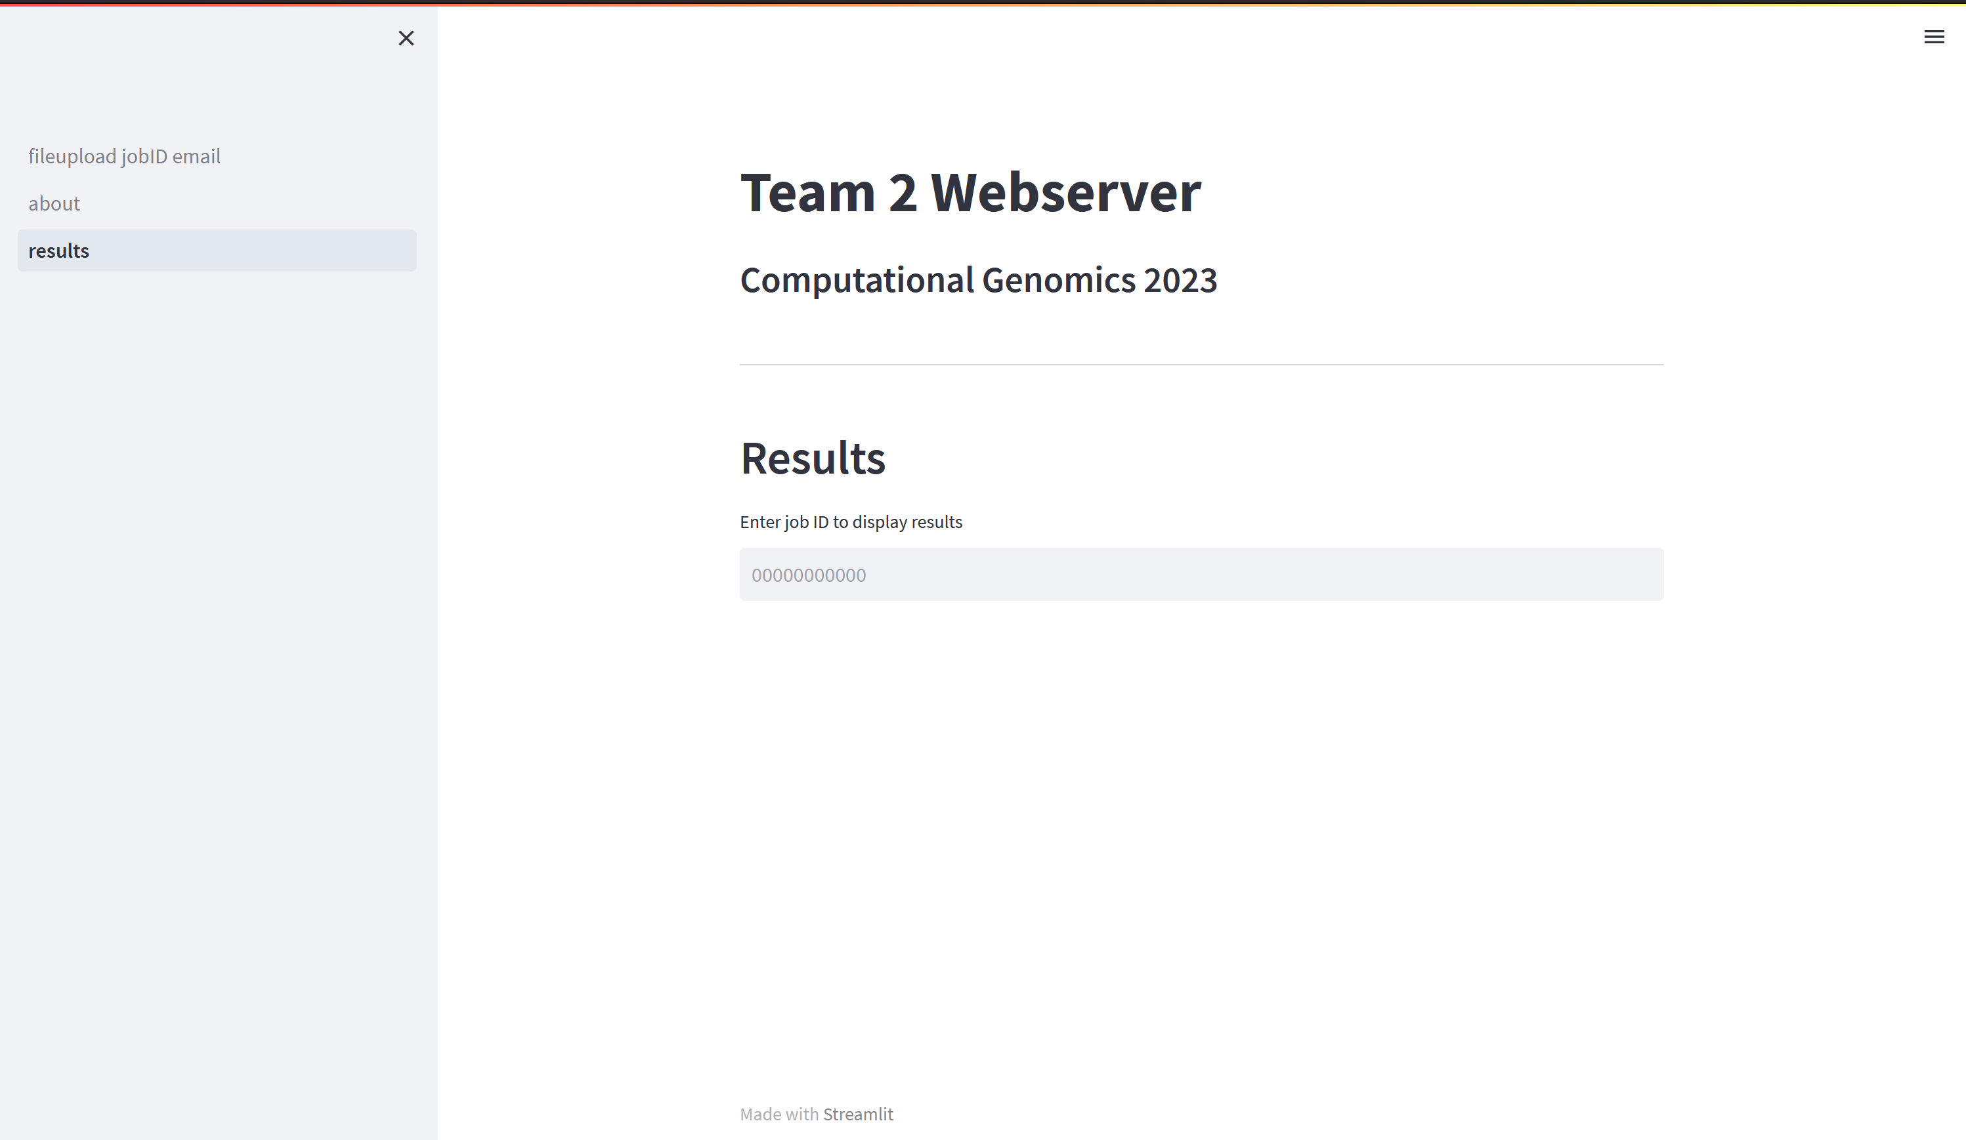
Output Page

Slide 16
